Slide 1
HEALTHY RELATIONSHIPS

Slide 2
The following material is about healthy, unhealthy, and abusive relationship patterns and may cause discomfort. Please be aware of how you are feeling and remember to take care of yourself.
Please be mindful and respectful of those around you.
Remember that you may enter / re-enter the room as necessary, and that any reactions you are having are normal.

Slide 3
Partnered Activity
Directions
Split into Pairs
Take 1-2 minutes to tell your partner your life story.
The partner who is not telling their story may not speak or respond.

Slide 4
The Relationship Spectrum
Communicating
Respectful
Trusting
Honest
Equal
Enjoying personal time
Making mutual sexual choices
Economic/financial partners
Not communicating
Disrespectful
Not trusting
Dishonest
Trying to take control
Only time with partner
Pressured into sexual activities
Unequal economically
Communicates with threats
Mistreats the other
Accuses cheating
Denies abusive actions Controls the other
Isolates the other partner
Forces sexual activity or pregnancy
Exerts economic control

Slide 5
Setting Boundaries
WHAT IS A BOUNDARY?
WHAT BOUNDARIES HAVE YOU MADE BEFORE?
WHAT DO BOUNDARIES DO FOR US?
WHAT IF WE DO NOT KNOW OUR OWN BOUNDARIES?
PRACTICE BOUNDARIES, SET CONSQUENCES

Slide 6
Physical Boundaries
HEALTHY:
Does this feel good?
May I touch you here?
Knocking before entering.
Ask before hugging a friend
UNHEALTHY:
Coercion or pressure
Sex is not a currency
Pressure to use drugs or alcohol
Breaking or throwing objects
Harming pets

Slide 7
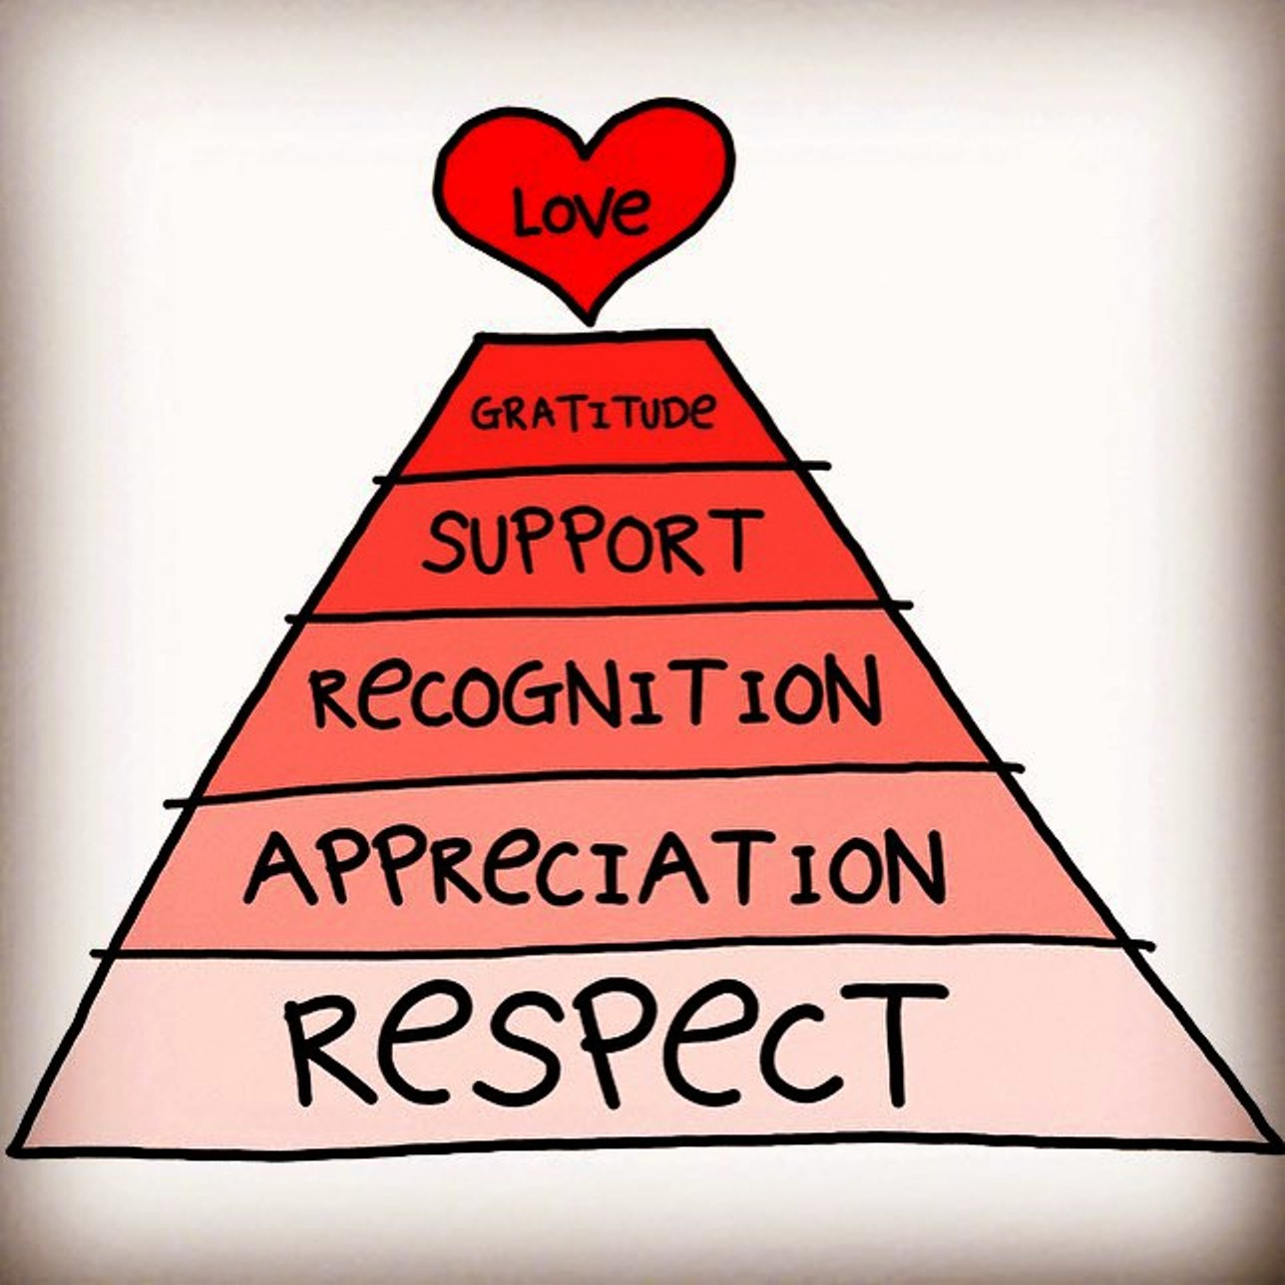
Emotional Boundaries
HEALTHY:
Supportive of your interests, hobbies, career
Expecting accountability
Remaining optimistic and open to change
Willingness to recognize fault and apologize
UNHEALTHY:
Jealous of friends and time spent with others
Controlling who you see, where you go, or what you do (***)
Using guilt and shame
Unrealistic Expectaitons
Too serious too quickly
Rigid ideas about gender roles

Slide 8
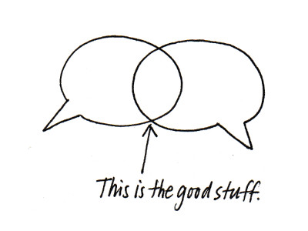
Verbal Boundaries
HEALTHY:
Can I be honest with you about something?
How are you feeling?
I feel ____ when you _____.
I respect you. / and that’s why _____.
Can you think of a compromise that will work for both of us?
I wish you would hold my hand more often. (Be Specific)
UNHEALTHY:
Threats toward you, family, or friends
Minimizing or demeaning
You always… / You never…
I wish you were more affectionate. (Don’t Be Vague)

Slide 9
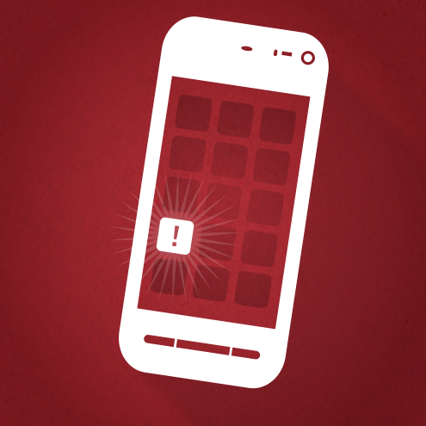
Tech & Social Media Boundaries
HEALTHY:
Is it okay to tag or check in?
Do we post our relationship status?
Is it okay to friend or follow my friends?
When is it okay to text me and what is the expectation for when we return it?
Is it okay to use each other’s devices?
Is it okay to post, tweet or comment about our relationship?
UNHEALTHY:
Sharing passwords
Sharing one social media account
Searching each other’s devices
Controlling the content you access and share online
Tracking your location

Slide 10
WHY TO REPORT
Many people only express these issues to close friends…
HIDDEN HARM: What we don’t know about one another…
Depression or other mental health issues
Been the victim of sexual assault.
Has had an alcohol or other addiction
Has seriously considered or attempted suicide
Has been abused physically or emotionally

Slide 11
Protecting The Pack: Spotting & Standing Up To Abuse
When To Intervene
Recognize the situation
Feel responsible to react
Choose how to respond
Take Action
Safe & Positive Options
Distract
Find Support
Make your presence felt
Speak up against abuse related humor or language

Slide 12
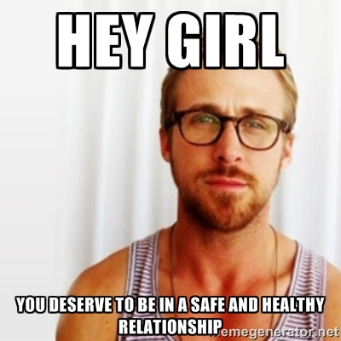
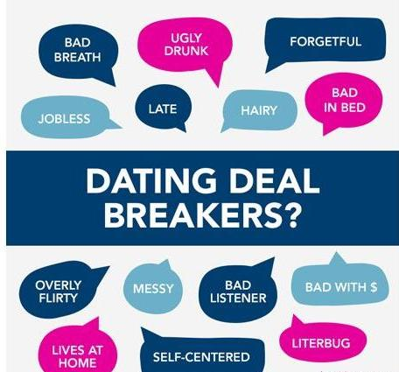
An Ideal Relationship / Friendship

Slide 13
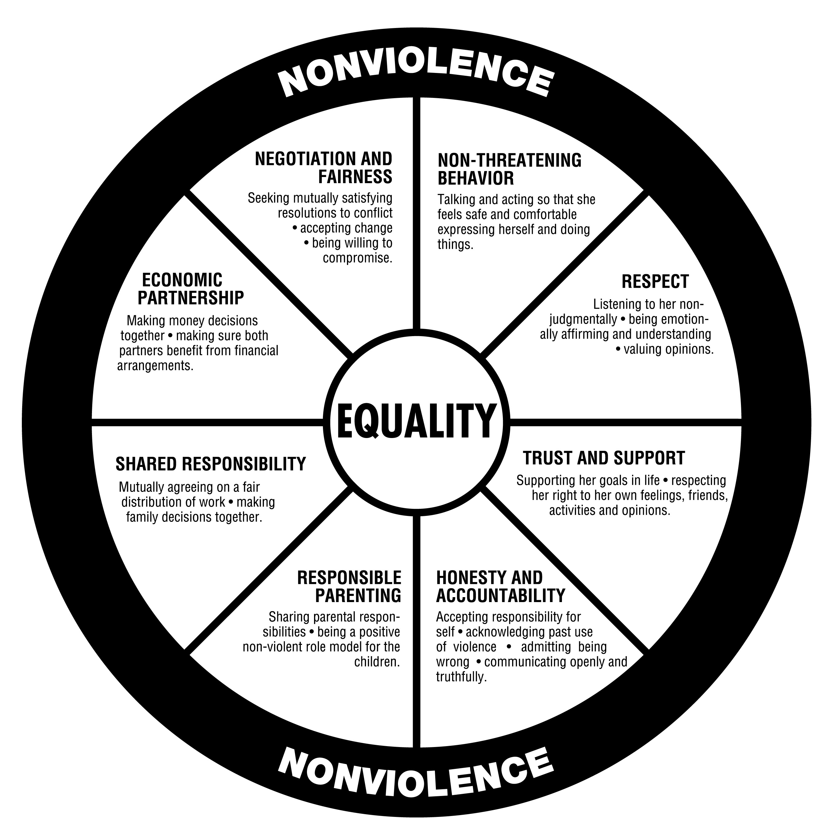
Where Can I Find Out More?
www.scareleteen.com “Sex Education for the Real World”
www.thehotline.org “National Domestic Violence Hotline”
www.theduluthmodel.org “Domestic Abuse Intervention Programs”
www.ncadv.org “National Coalition Against Domestic Violence”
www.loveisrespect.org “Love Is Respect”

